Slide 1

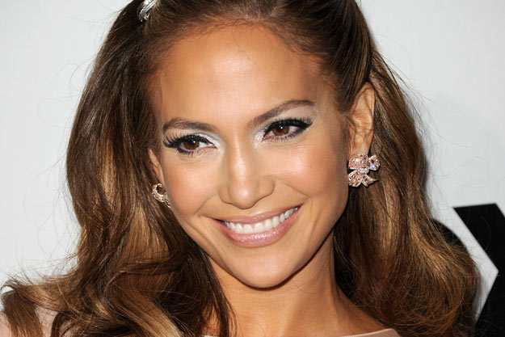
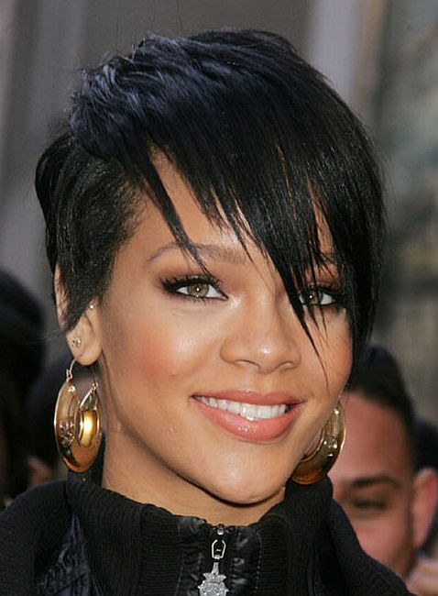

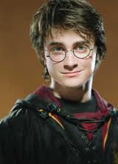
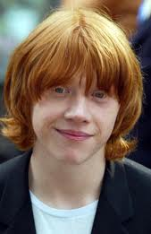

Slide 2
5A Listening Activity:
1/ Qui est Justin?
2/ Justin a quel âge?
3/ De quelle couleur sont les yeux et les cheveux de Justin?
4/ Ils ressemblent à qui?

Slide 3
5A Grammaire:
Possessive Adjectives

Slide 4
Possessive Adjectives:
Possessive Adjectives | Masculine/Singular | Feminine before a consonant/Singular | Plural (masculine or feminine)
My | Mon | Ma | Mes
Your (informal) | Ton | Ta | Tes
His/Her/ One’s/Its | Son | Sa | Ses
Our | Notre | Notre | Nos
Your (formal) | Votre | Votre | Vos
Their | Leur | Leur | Leurs
The possessive adjectives agrees (gender, singular, plural) with the noun/object that it is describing (NOT WITH THE OWNER/PERSON SPEAKING).
Example: Mon cahier est vert.
My notebook is green.
It does not matter if it is a boy or girl speaking. You would use “mon” because cahier is masculine.
Example: Luc aime sa belle-mère.
Luc likes his mother-in-law.
It does not matter that Luc is a boy. It is “sa” because belle-mère is feminine.

Slide 5
Possessive Adjectives:
Possessive Adjectives | Masculine/Singular/ Before a vowel | Feminine before a consonant/Singular | Plural (masculine or feminine)
My | Mon | Ma | Mes
Your (familiar) | Ton | Ta | Tes
His/Her/ One’s/Its | Son | Sa | Ses
Our | Notre | Notre | Nos
Your (formal) | Votre | Votre | Vos
Their | Leur | Leur | Leurs
When a Feminine/Singular word begins with a VOWEL:
DO NOT USE THE FEMININE SINGULAR COLUMN!!!
INSTEAD USE THE MASCULINE SINGULAR COLUMN!!!
LOOK AT WHAT HAPPENS:
My poster: Ma affiche.
We don’t want two vowels together!
So, instead, switch to the masculine “my.”
Mon affiche.
☺MUCH BETTER! ☺

Slide 6
Possessive Adjectives:
Possessive Adjectives | Masculine/Singular/ BEFORE A VOWEL | Feminine /Singular | Plural (masculine or feminine)
My | Mon | Ma | Mes
Your (informal) | Ton | Ta | Tes
His/Her/One’s/Its | Son | Sa | Ses
Our | Notre | Notre | Nos
Your (formal) | Votre | Votre | Vos
Their | Leur | Leur | Leurs
Put the proper possessive adjective in front of each:
______ oncle – my
______ trousse – your (informal)
______ livre – her
______ salle de classe – our
______ fenêtres – my
______ beau-père – their
______ tante – your (formal)
______ omelette – her

